Slide 1
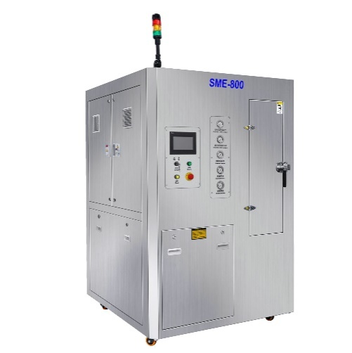
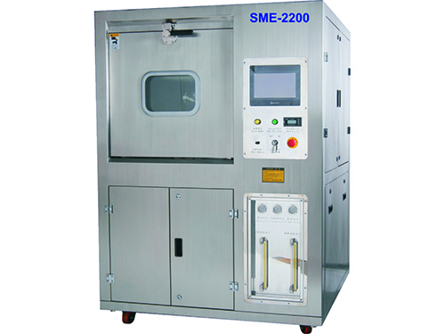
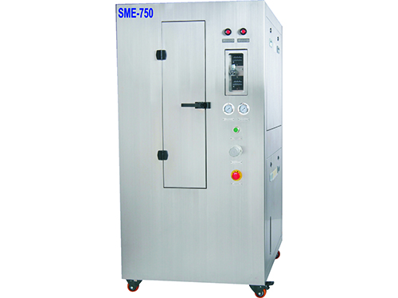
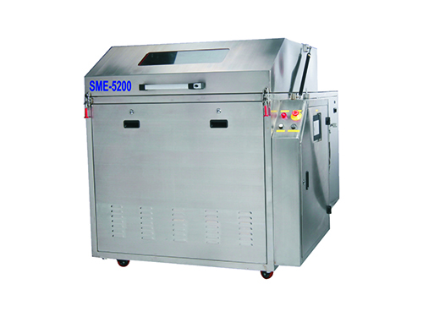
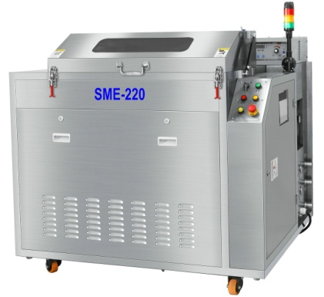
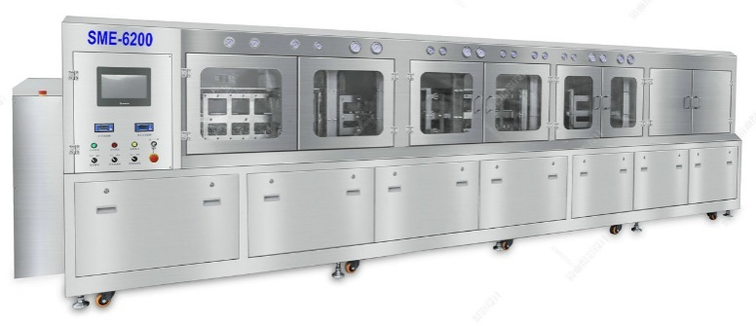
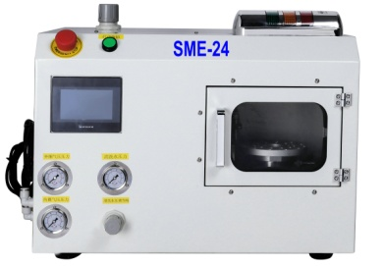
SMT Cleaning Machine
Samtronik—Professional Cleaning Equipments Supplier for SMT & PCB
Electric stencil cleaning machine
Pneumatic stencil cleaning machine
Wave oven fixture cleaning machine
Offline PCBA cleaning machine
Inline PCBA cleaning machine
Squeegee cleaning machine
Nozzle cleaning machine
Mis-print PCB cleaning machine, Squeegee cleaning machine, reflow over cleaning machine…

Slide 2



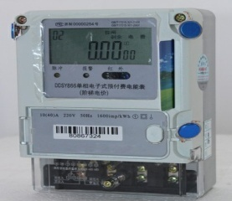
Samtronik—Professional Cleaning Equipments Supplier for SMT & PCB
PCBA Cleaning Machine Introduction
SME-5600 PCBA cleaning machine is an energy-saving environmental protection, batch cleaning, integrated high-end cleaning machine. It can automatically complete cleaning, rinsing, drying process by just push the start key.
Mainly used for aviation, aerospace, medical, new energy, automotive electronics and other products . This machine can effectively clean residual rosin flux, water-soluble flux , No-clean flux / solder paste ball and other organic and inorganic pollution materials on SMT / THT PCBA.

Slide 3
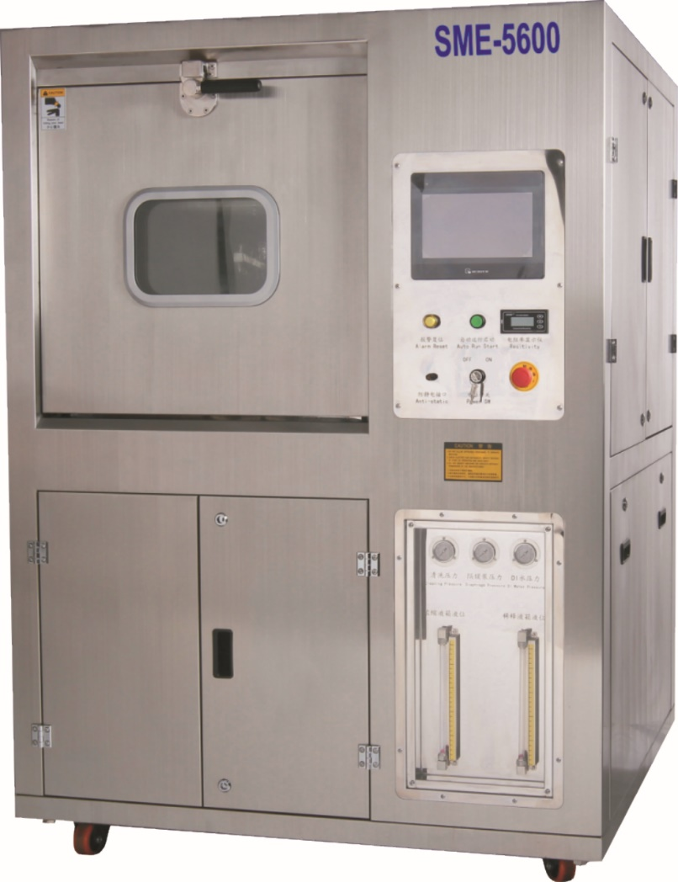
Samtronik—Professional Cleaning Equipments Supplier for SMT & PCB
PCBA Cleaning Machine SME-5600

Slide 4
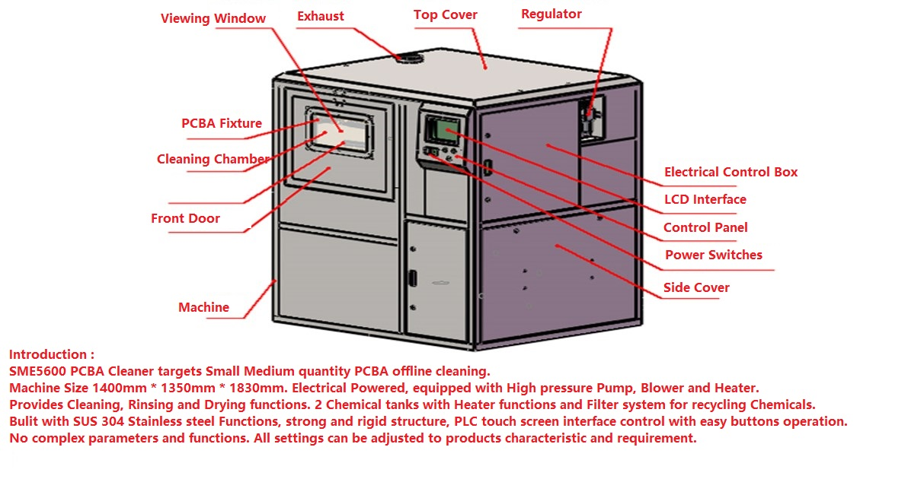
Samtronik—Professional Cleaning Equipments Supplier for SMT & PCB
SME-5600 Descriptions

Slide 5
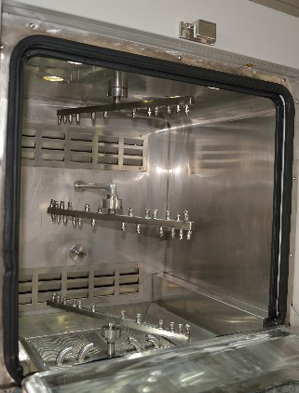
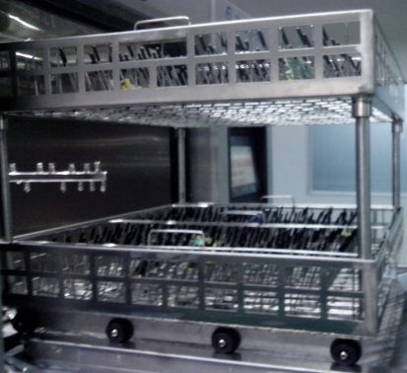
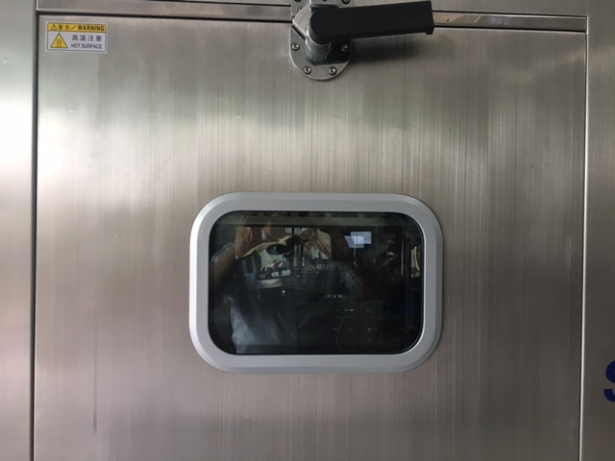
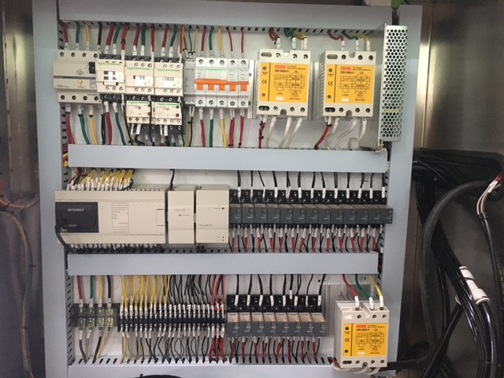
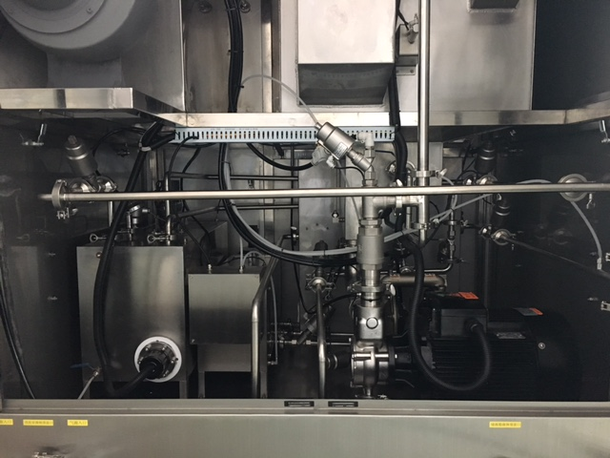
Samtronik—Professional Cleaning Equipments Supplier for SMT & PCB
Big cleaning room
Dual layers leaning basket
Visible window
Control box
Inside pipes

Slide 6
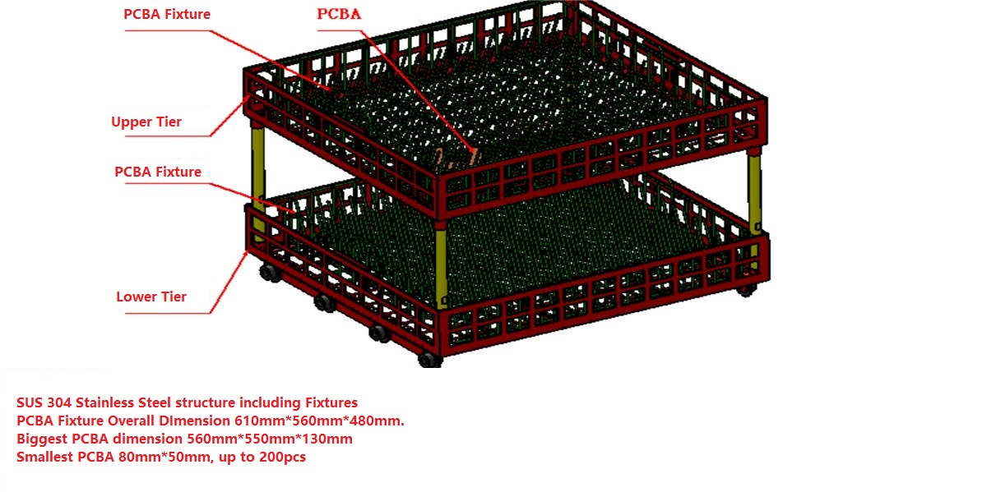
Samtronik—Professional Cleaning Equipments Supplier for SMT & PCB
SME-5600PCBA清洗篮说明

Slide 7
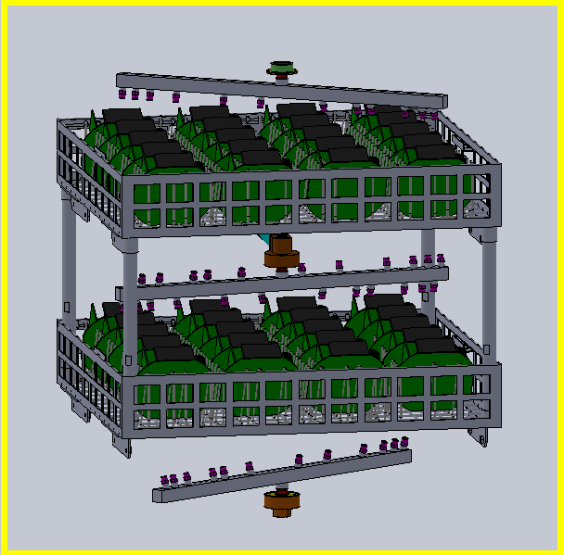
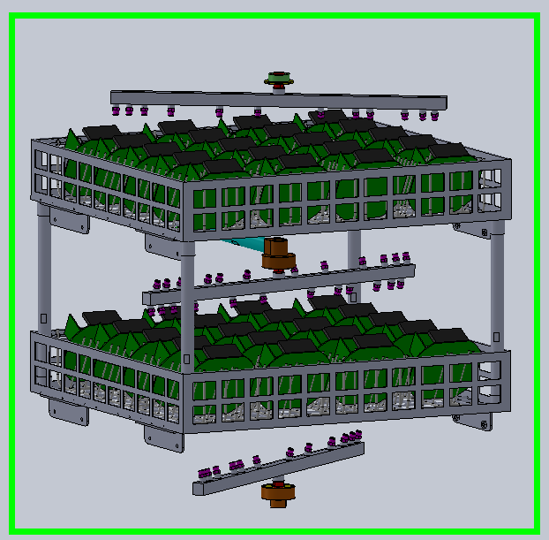
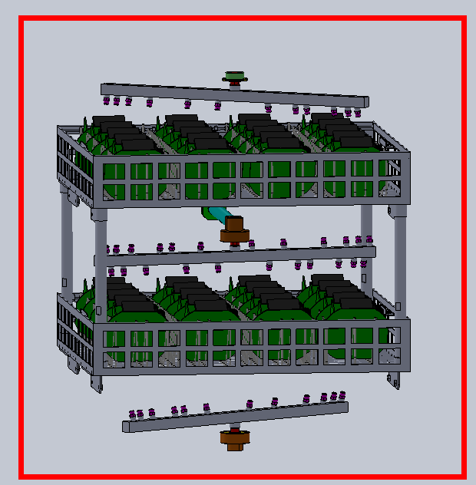
Samtronik—Professional Cleaning Equipments Supplier for SMT & PCB
SME-5600 Cleaning Process
Chemical detergent clean ---- DI water Rinse ---- Hot air Drying
Upper/middle/lower 3 360° rotation spray rods, 2 layers cleaning basket

Slide 8
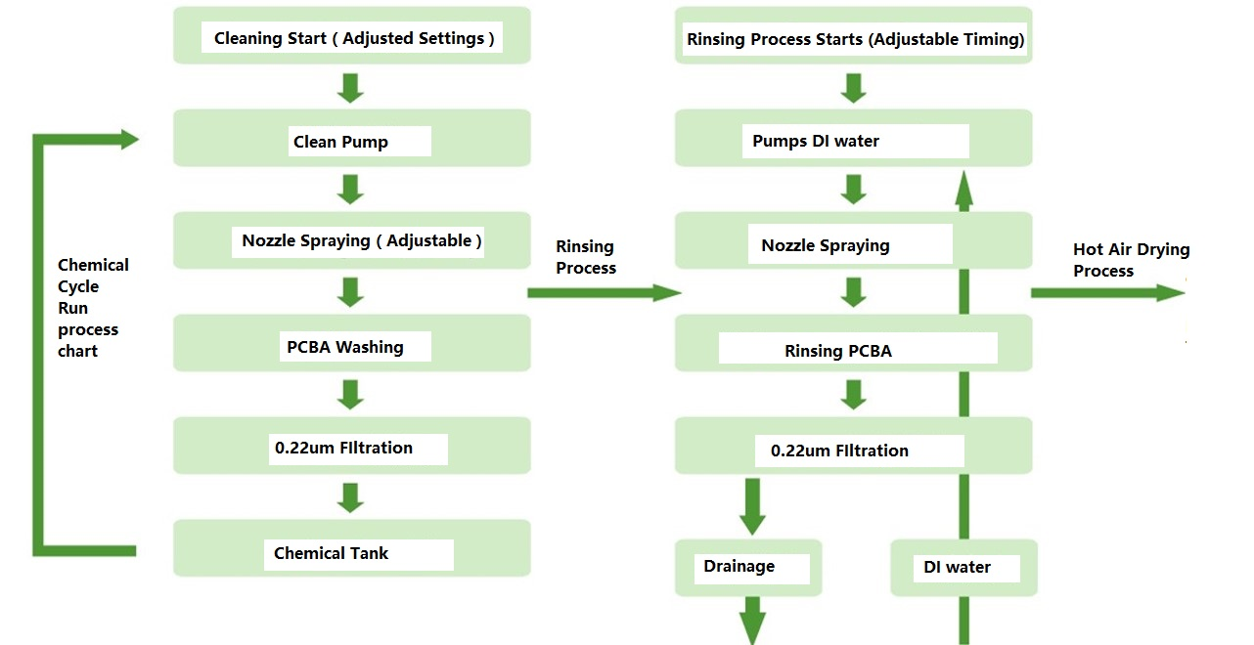
Samtronik—Professional Cleaning Equipments Supplier for SMT & PCB
（1）Operation Process
In general, the cleaning process parameters are: cleaning time (10-20) min, rinse time (1-2) min, rinse times (3-5) times, drying time (20-30) min, cleaning temperature (40 -60) ℃, rinse temperature (room temperature), drying temperature (70-95) ℃, so the general completion of a cleaning process time (40-60) min, under special circumstances according to the actual situation

Slide 9
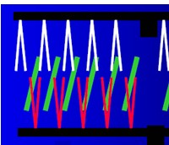
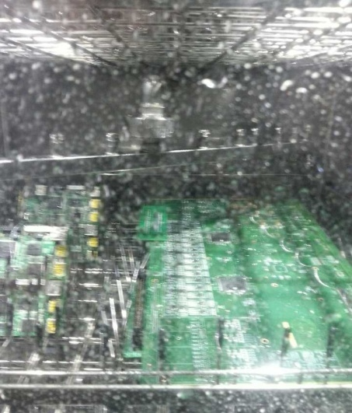
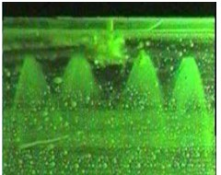
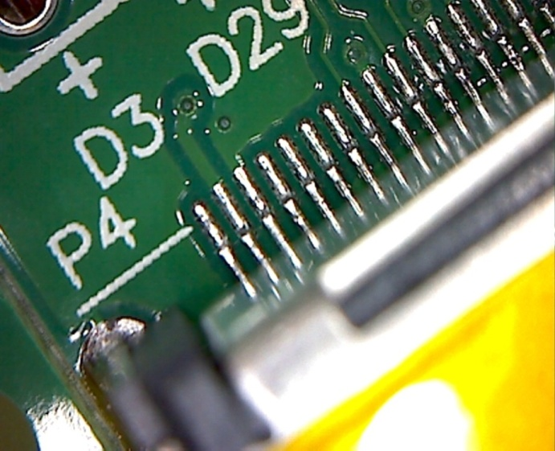
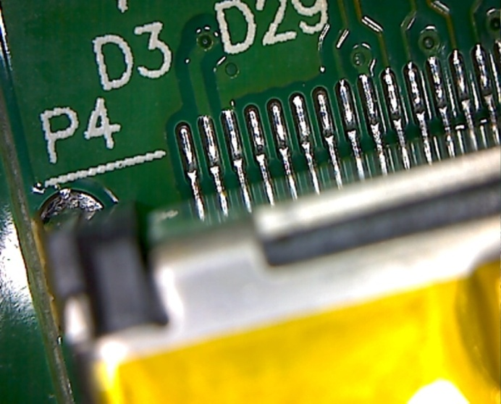
Flux Residue
Samtronik—Professional Cleaning Equipments Supplier for SMT & PCB
（2）Cleaning Method
Spray Clean
（3）Cleaning Results
Before
After

Slide 10
Samtronik—Professional Cleaning Equipments Supplier for SMT & PCB
（4）Specifications
Item | parameters
Cleaning basket size： | 610mm(L)*560mm(W)*100mm(H)x 2 layers
Concentration liquid tank capacity | 30L
Dilution tank capacity | 60L
Spray tank capacity | 18L
Temporary tank heater | 6KW
Cleaning time | 0~99min(adjustable)
liquid temp | Room temp -75 degrees / (adjustable)
Rinse time | 1-99 times / 1~2min each time
Rinse water temp | Room temp -75 degrees / (adjustable)
Drying time | 0 to 99 minutes / (adjustable)
Resistivity meter monitoring range | 0~18MΩ
liquid tank heater | 9KW
Item | parameters
Drying Temperature: | Room Temp--99℃ /（Adjustable）
Drying Heater/KW： | 6KW
Spray Pressure： | 30PSI - 80PSI/(Adjustable）
Chemical liquid level filter： | 0.22μm (filter microparticles: solder paste, rosin, flux and contaminants)
DI water Filter： | 0.22μm (filter microparticles: solder paste, rosin, flux and contaminants)
water inlet： | 1 inch fast junction interface
Water outlet： | 1 inch fast junction interface
Chemical Inlet： | 1 inch fast junction interface
Real - time pressure gauge： | 3PCS (nozzle / DI water / waste liquid)
pump： | 5.5KW
Outlet size： | Φ100W)×30mm(H)
Power source： | AC380V 50HZ 65A/0.45MPa~0.7MPa
Weight： | 600Kg
Machine Dimension： | 1300mm(L)×1200mm(W)× 1850mm(H)

Slide 11
Samtronik—Professional Cleaning Equipments Supplier for SMT & PCB
（5) Features
1. the whole process visible : the cleaning process can be visible through the front window and LED light.
2. automatic cleaning mode: clean, rinse, dry process can complete in one cabinet and compact machine.
3. the most scientific nozzle design: the use of left and right incremental distribution --- to enhance cleaning efficiency,
The upper and lower dislocation distribution - completely solve the cleaning blind area;
4. the nozzle pressure adjustable design: to solve the small and light PCBA in the high pressure spray under the conditions of the collision, splash problem;
5. the standard dilution tank heating system: greatly improve the cleaning efficiency. Shorten the cleaning time;
6. a comprehensive cleaning system: for SMT; THT PCBA after welding the surface of the residual rosin, water-soluble flux, no-clean flux / solder paste and other organic and inorganic pollutants for thorough and effective cleaning;
7. convenient cleaning dilution to add: can be manually added, but also by setting the ratio (5% to 25%) automatically with DI water and chemical liquid (option);

Slide 12
（5) Features
Samtronik—Professional Cleaning Equipments Supplier for SMT & PCB
8. Temporary tank and auxiliary heating system: Temporary tank is used to store dilution and DI water.
During cleaning process, the air pump absorb dilution form dilution tan and send to temporary tank ,then wash pump absorb dilution from temporary tank to clean PCBA. After cleaning process, the air pump absorb dilution from temporary tank and send them back to dilution tank.
During rinsing process, the air pump absorb DI water from DI water produce machine and send it to temporary tank, each time after rinsing ,DI water will be discharged form temporary tank. The rinse water can be heated as needed;
9. Lower operating costs: built-in filter makes the dilution repeated used. By using compressed air blow method at the end of cleaning process : blow the residual detergent off from pipeline and the pump , which effectively save 50% dilution.
10. The concentration lqiuid compensation function: the concentration of dilution will be getting lower and lower after repeated use which will affect the cleaning effect and cleaning efficiency of PCBA, at this time , need to add some concentrated liquid to dilution tank to compensate the dilution concentration. concentration compensation can improve the effective use of liquid, the concentration liquid adding amount can be adjustable according to the real situation.

Slide 13
Samtronik—Professional Cleaning Equipments Supplier for SMT & PCB
Accessairies1：
Waste rinse water treament machine
rinsed waste DI water treatment machine
SME-200（OPtion）
waster DI water after rinsed
PCBA cleaning machine
SME-5600
DI水
tap water
solid waste
Rinsed DI water recirculated used, no waste water drained, only small amount of solid waste. combine with DI water producing machine and rinsed waste DI water recirculation used.

Slide 14

Samtronik—Professional Cleaning Equipments Supplier for SMT & PCB
2.Accessairies 2：
DI water producing machine DI-250(Turn tap water into DI water）
Rinsed DI water
PCBA cleaning machine SME-5600
waste DI water colletion pool
DI水
DI water produing machine
（option）
tap water
pay and handle wasted DI water to related environment protection company
flitered water, drain
7）Operation, cleaning, control
Colorful touch screen + PLC control, cleaning procedures and parameter are easy to edit and modified on it. one-button easy operation, cleaning baskets are easy to load and unload.

Slide 15
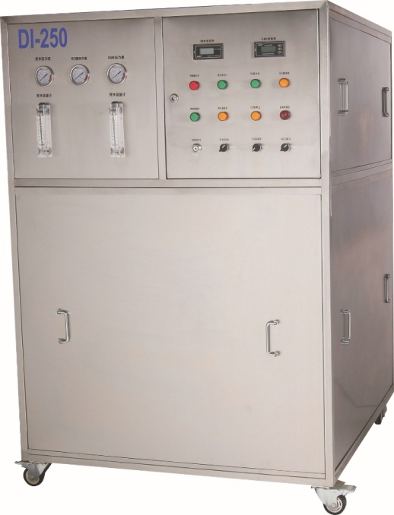
DI Water Machine(DI-250)
Samtronik—Professional Cleaning Equipments Supplier for SMT & PCB
If customer has no DI water then they need to buy one DI water machine.
1. DI water machine is used to turn tap water into DI water and supply to the PCBA cleaning for rinsing after cleaning.
2. DI water will be discharged after rinsing and normally need to rinse 3~4 times after cleaning, each rinse will cost 20L DI water.
3. DI-250 DI water machine will produce 250L DI water in one hour.
4. DI-250 DI water outlet resistance is ＞10MΩ

Slide 16

Samtronik—Professional Cleaning Equipments Supplier for SMT & PCB
Welcome to visit our factory and do cleaning test！
Samtronik SALES DEPARTMENT
2019

